Slide 1
MACHINE LEARNING HACKTHON
Team Name – __ML_HUNT__
Team Leader Name – Naga Vijaya Tejasri Masina
Team Leader Email – 20pa1a5430@vishnu.edu.in

Slide 2
About the Problem statement: Identifying Healthcare Professionals (HCP) and their specialization
The problem at hand is to identify healthcare professionals (HCP) and their specialization using ad server logs. The ad server logs contain valuable information such as browser details, IP addresses, geographic locations, search patterns, site URLs, and other relevant data.
The objective of the problem is to build a robust model that can accurately predict whether a user belongs to the HCP category and determine their specialization taxonomy. In other words, given a user's behavior data and other features from the ad server logs, the model should be able to classify the user as an HCP or non-HCP (IS_HCP) and identify their specific specialization (TAXONOMY).
To solve this problem, various steps need to be performed, including data cleaning, exploratory data analysis, feature engineering, model training, and evaluation. The model will be trained on historical data containing information about HCPs and their specialization, and then it will be used to predict the HCP status and taxonomy for new user data.

Slide 3
Solution Proposed :
The objective of this project is to develop a solution that can accurately identify healthcare professionals (HCPs) and predict their specialization taxonomy based on ad server logs. The solution involves several steps, including data preprocessing, exploratory data analysis (EDA), feature engineering, model training, evaluation, and generating predictions.
The proposed solution for the given problem statement involves using the Random Forest algorithm to predict healthcare specialization (HCP) based on the provided features. Random Forest is a versatile and powerful algorithm known for its ability to handle complex relationships and provide accurate predictions.

Slide 4
Data Preprocessing : In data preprocessing, missing values are handled by either dropping them or imputing them using appropriate techniques. Categorical variables are encoded using label encoding or one-hot encoding to convert them into numerical representations. These steps ensure the data is ready for analysis and model training. Exploratory Data Analysis (EDA): EDA involves analyzing data distribution and visualizing patterns to gain insights into variable relationships, detect outliers, and explore trends or correlations. It plays a crucial role in understanding the data and guiding modeling decisions.
Approach:

Slide 5
Feature Engineering:
Feature engineering involves creating new features from existing data or transforming existing features to improve the performance of the model. This process aims to capture relevant information, reduce noise, and enhance the predictive power of the features used for training the model.
Model Training:
The model was trained using the Random Forest algorithm, a powerful ensemble learning technique that combines multiple decision trees to make predictions. Random Forest is known for its ability to handle complex datasets, handle both categorical and numerical features, and effectively capture non-linear relationships. It provides robustness against overfitting and performs well in a variety of classification tasks.
Model evaluation :
The model achieved impressive accuracy rates of 98% for hcp prediction and 91% for taxonomy prediction, demonstrating its strong classification performance.

Slide 6
Generate Predictions:
The trained model is applied to the test data to generate predictions for HCP detection and specialization. This allows us to classify the test instances and determine the healthcare professional status and corresponding specialization.
Prepare Output: The predictions for HCP and specialization are used to create an output file that follows the specified format in the data dictionary. This file can be submitted for evaluation and scoring of the model's performance.

Slide 7
Execution Demo (Screenshots) of the solution

Slide 8

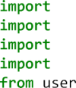
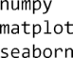
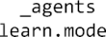
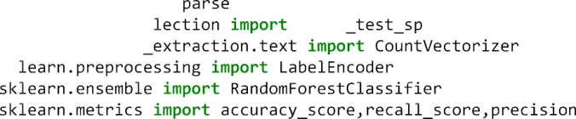
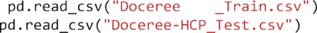
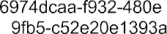
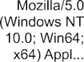

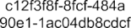
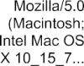

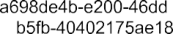
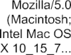

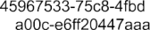
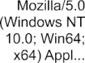

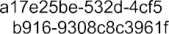
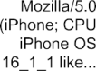


Slide 9
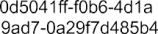
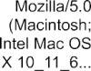

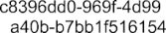
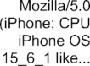

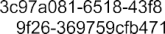
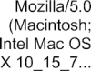


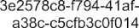
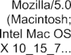


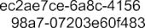
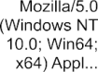

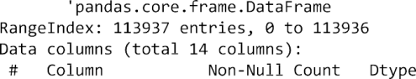
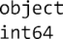
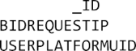
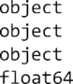
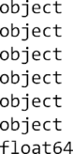
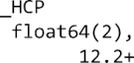

Slide 10
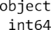
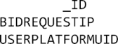
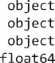
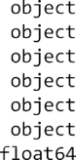
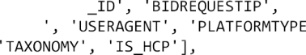

Slide 11
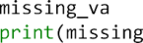
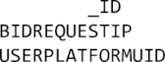
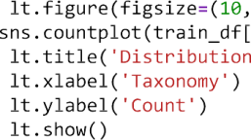
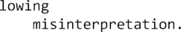
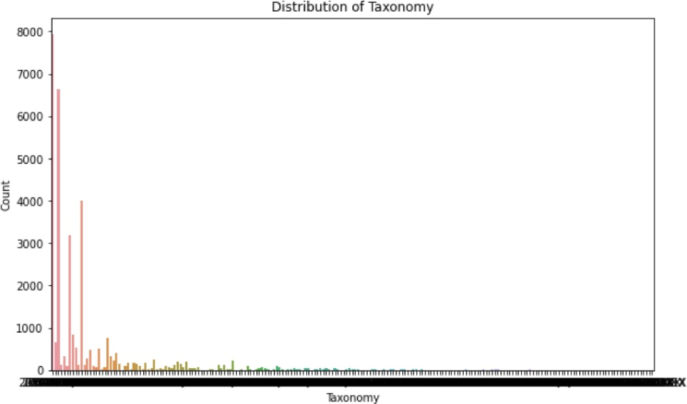

Slide 12
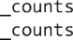
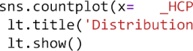
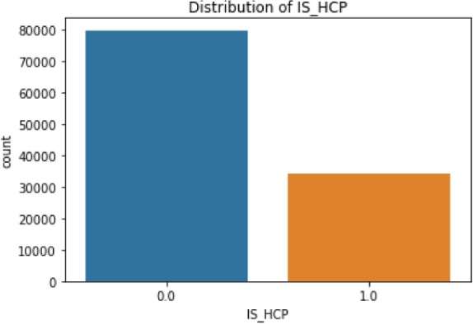
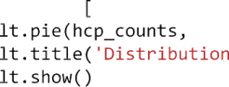
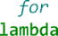
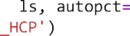
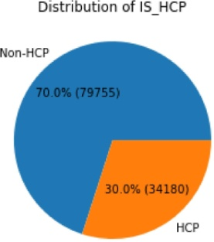

Slide 13

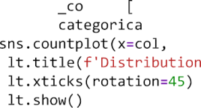
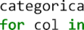




Slide 14








Slide 15









Slide 16




















Slide 17

















Slide 18











Slide 19









Slide 20





Slide 21


Slide 22
Source Code in Github
GITHUB URL :
https://github.com/Tejasri-123/DOCEREE-HACKTHON

Slide 23
Thank you

